Slide 1
Module 4.6:
Anonymization
The pitfalls of treating data as anonymous
ML for Cybersecurity

Slide 2
Anonymity is Hard to Achieve
“…a tension that shakes a foundational belief about data privacy: Data can be either useful or perfectly anonymous but never both.” Paul Ohm, Privacy Law Scholar

Slide 3
PERSONAL DATA

Slide 4
Personally Identifiable Information (PII)
2010 NIST Special Publication 800-122 Guide to Protecting the Confidentiality of Personally Identifiable Information (PII)
PII: “(1) any information that can be used to distinguish or trace an individual’s identity, such as name, social security number, date and place of birth, mother‘s maiden name, or biometric records; and (2) any other information that is linked or linkable to an individual, such as medical, educational, financial, and employment information.”
General Data Protection Regulation (GDPR)
Personal data: “any information relating to an identified or identifiable natural person… name, an identification number, location data, an online identifier or to one or more factors specific to the physical, physiological, genetic, mental, economic, cultural or social identity of that natural person”

Slide 5

Some Types of PII
Name (full name, alias)
Identification number (SSN, passport #)
Address (street address, email address)
IP address / MAC address
Telephone number
Photo, x-rays, fingerprints
Information linkable to those above

Slide 6
Anonymization Techniques

Slide 7
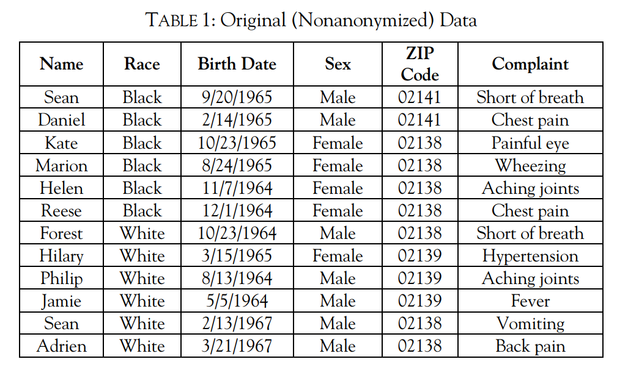
Nonanonymized Data
From Paul Ohm. Broken Promises of Privacy: Responding to the Surprising Failure of Anonymization. UCLA Law Review Vol. 57, p. 1701, 2010.

Slide 8
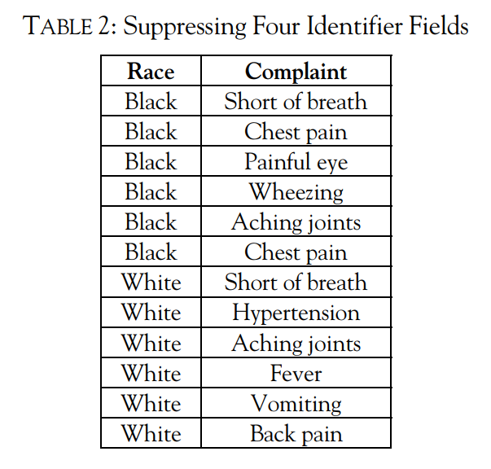
Suppression (Deleting/Omitting Data)
From Paul Ohm. Broken Promises of Privacy: Responding to the Surprising Failure of Anonymization. UCLA Law Review Vol. 57, p. 1701, 2010.

Slide 9
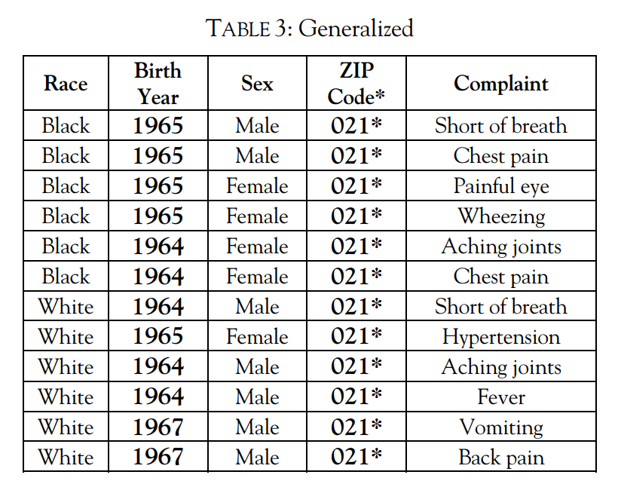
Generalization (Re-code as Less Granular)
From Paul Ohm. Broken Promises of Privacy: Responding to the Surprising Failure of Anonymization. UCLA Law Review Vol. 57, p. 1701, 2010.

Slide 10
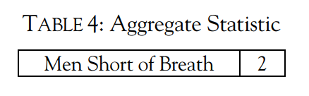
Aggregation (Release Summary)
From Paul Ohm. Broken Promises of Privacy: Responding to the Surprising Failure of Anonymization. UCLA Law Review Vol. 57, p. 1701, 2010.

Slide 11
Finding Personal Data

Slide 12
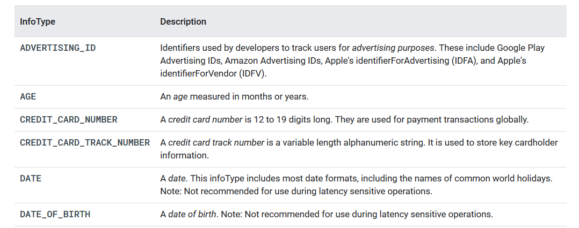
Data-Release Stewardship
Example: Google’s Cloud Data Loss Prevention (DLP) API
https://cloud.google.com/dlp/docs/infotypes-reference
Uses heuristics to try to identify particular information types

Slide 13
Famous Failures

Slide 14

Uniqueness of Data
Mid 1990s: Group Insurance Commission (GIC)
Upon request, GIC will release records with 100 attributes for state employee hospital visits
Latanya Sweeney, “Uniqueness of Simple Demographics in the U.S. Population”
87%: ZIP code + full Date of Birth + Sex is uniquely identifying
53%: City + full Date of Birth + Sex is uniquely identifying
18%: County + full Date of Birth + Sex is uniquely identifying

Slide 15

AOL Search Data
AOL Research released 20,000,000 search queries for 650,000 users of AOL’s search engine (3 months)
Replaced AOL username and IP address with unique pseudonymous identifier

Slide 16
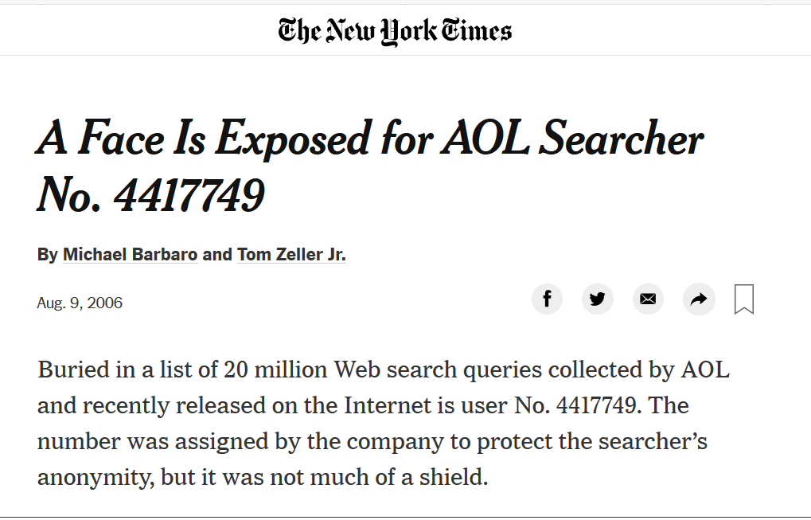
AOL Search Data

Slide 17

Netflix Data
Netflix released 100,000,000 records from 500,000 users, each given a unique ID
Each record included the pseudonymous identifier, the movie watched, the rating (1-5 stars), and rating’s date

Slide 18

Netflix Data
Narayanan and Shmatikov correlated with IMDb data
Ratings on IMDb are public
Databases are not perfect subsets of each other

Slide 19
Business ApplICations

Slide 20
Anonymity’s Interaction With Cybersecurity ML
Are you removing PII before training your model?
Do other features implicitly encode identifiable data?
Will the underlying data be released?
Can an attacker learn the underlying data from your trained model (model inversion attack)?

